Slide 1

AR-Alchemy
AR Project Team 10
Ao Gao, Fabian Nhan, Klejdi Sinollari, Sheng-Chia Yu, Chang Luo
19. June. 2022
Notes:
Greeting stuffs

Slide 2



Inspiration
🔥+💧=☁️
Discover Element Combination
Notes:
Some ideas are from Little Alchemy, explain simple game rules, the goal of the game

Slide 3





Frameworks
Unity AR Foundation for detecting and tracking Image
Unity AR Foundation
DOTween for tweening moving animation
ARKit
ARCore
Notes:
Some brief introduction of our used frameworls, elaborate some features from AR Foundation, why we choose that?
Use ARKit for iOS, and ARCore for Android Platform.
And DOTween for moving 3d model animation

Slide 4




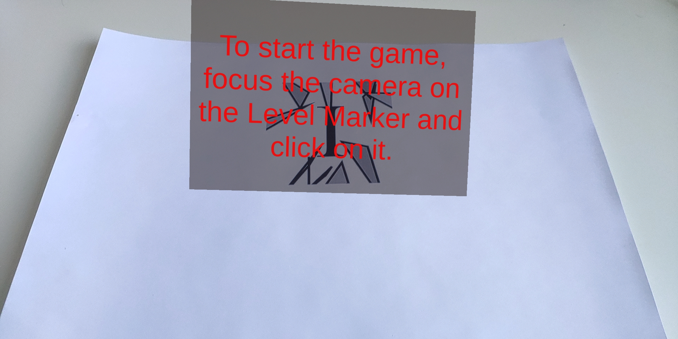
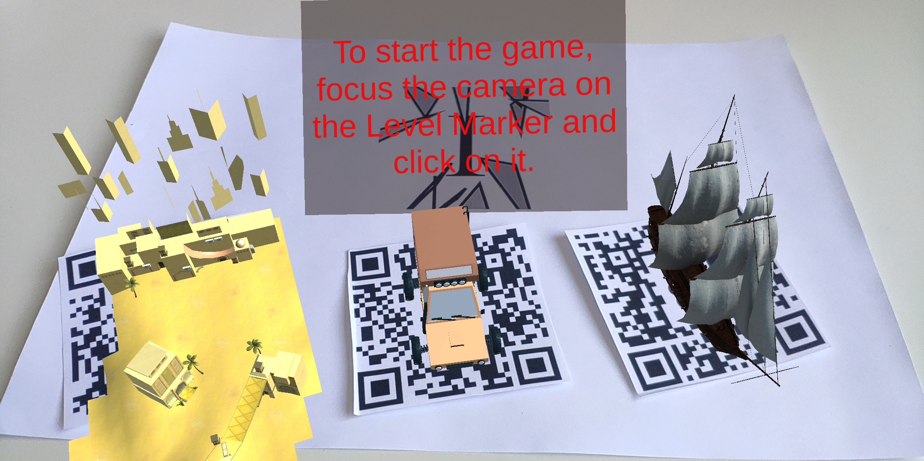

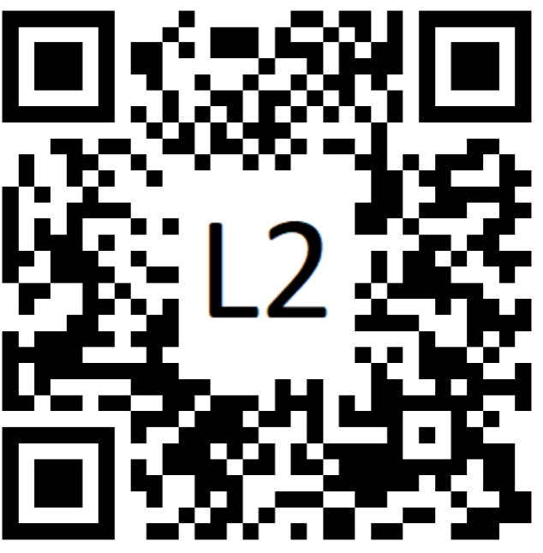
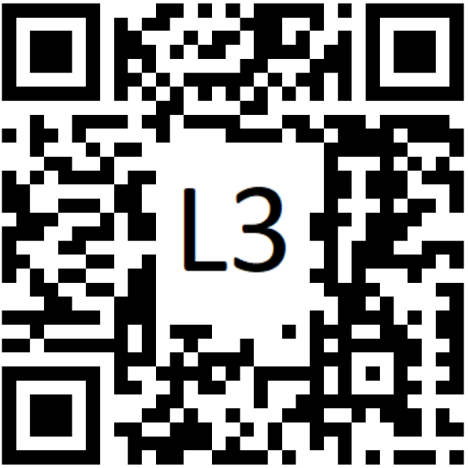
Gameplay - Instruction
Scan the instruction marker to get instruction for playing
Scan Level Marker and tap it to get in Level playing
Click to start Level
Level 1
OasisCity
Level 2
Car
Level 3
Ship
Instruction Marker
Notes:
Instruction marker function, what is instruction marker, how to start, level selecting

Slide 5

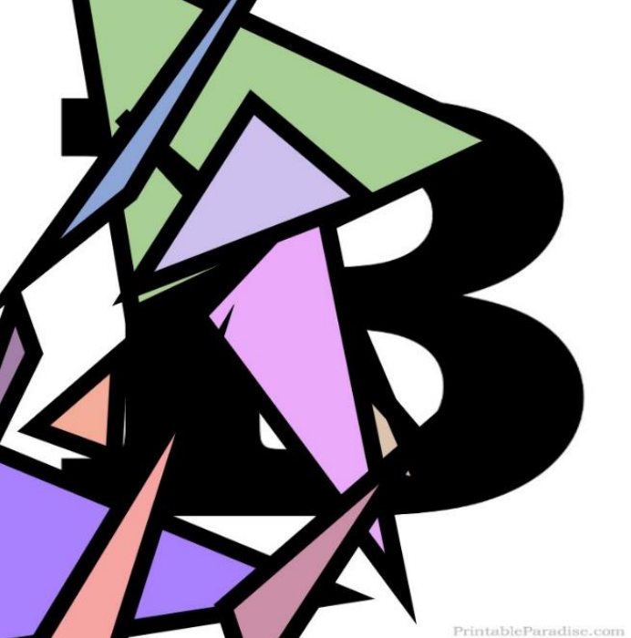


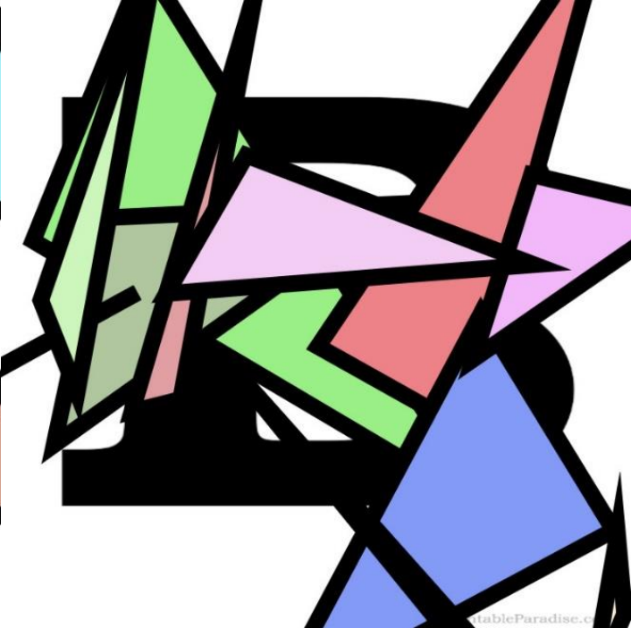
Gameplay – Basic Elements
Each level, 5 basic elements marker, player start from combing basic elements
Generated by https://danilogr.github.io/AR-Marker-Generator/
🔥
💧
☁️
🪨
⏳
Level 1
Fire
Water
Cloud
Soil
Time
🦾
🪵
Level 2
. . . . . . . . . . . . . . . . . . . . . . . . . . . .
Metal
Wood
Notes:
What is Basic Elements? For each level there will be different basic elements, marker generated on website

Slide 6
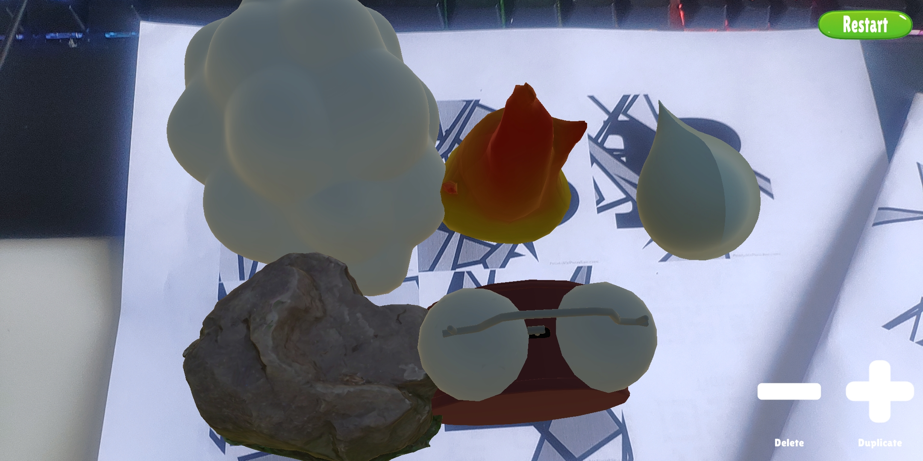
Gameplay – Basic Elements
Each level, 5 basic elements marker, player start from combing basic elements
Notes:
Detected basic elements, and rendered 3d models on it

Slide 7

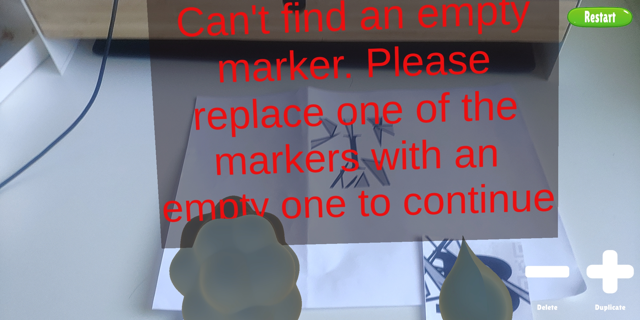
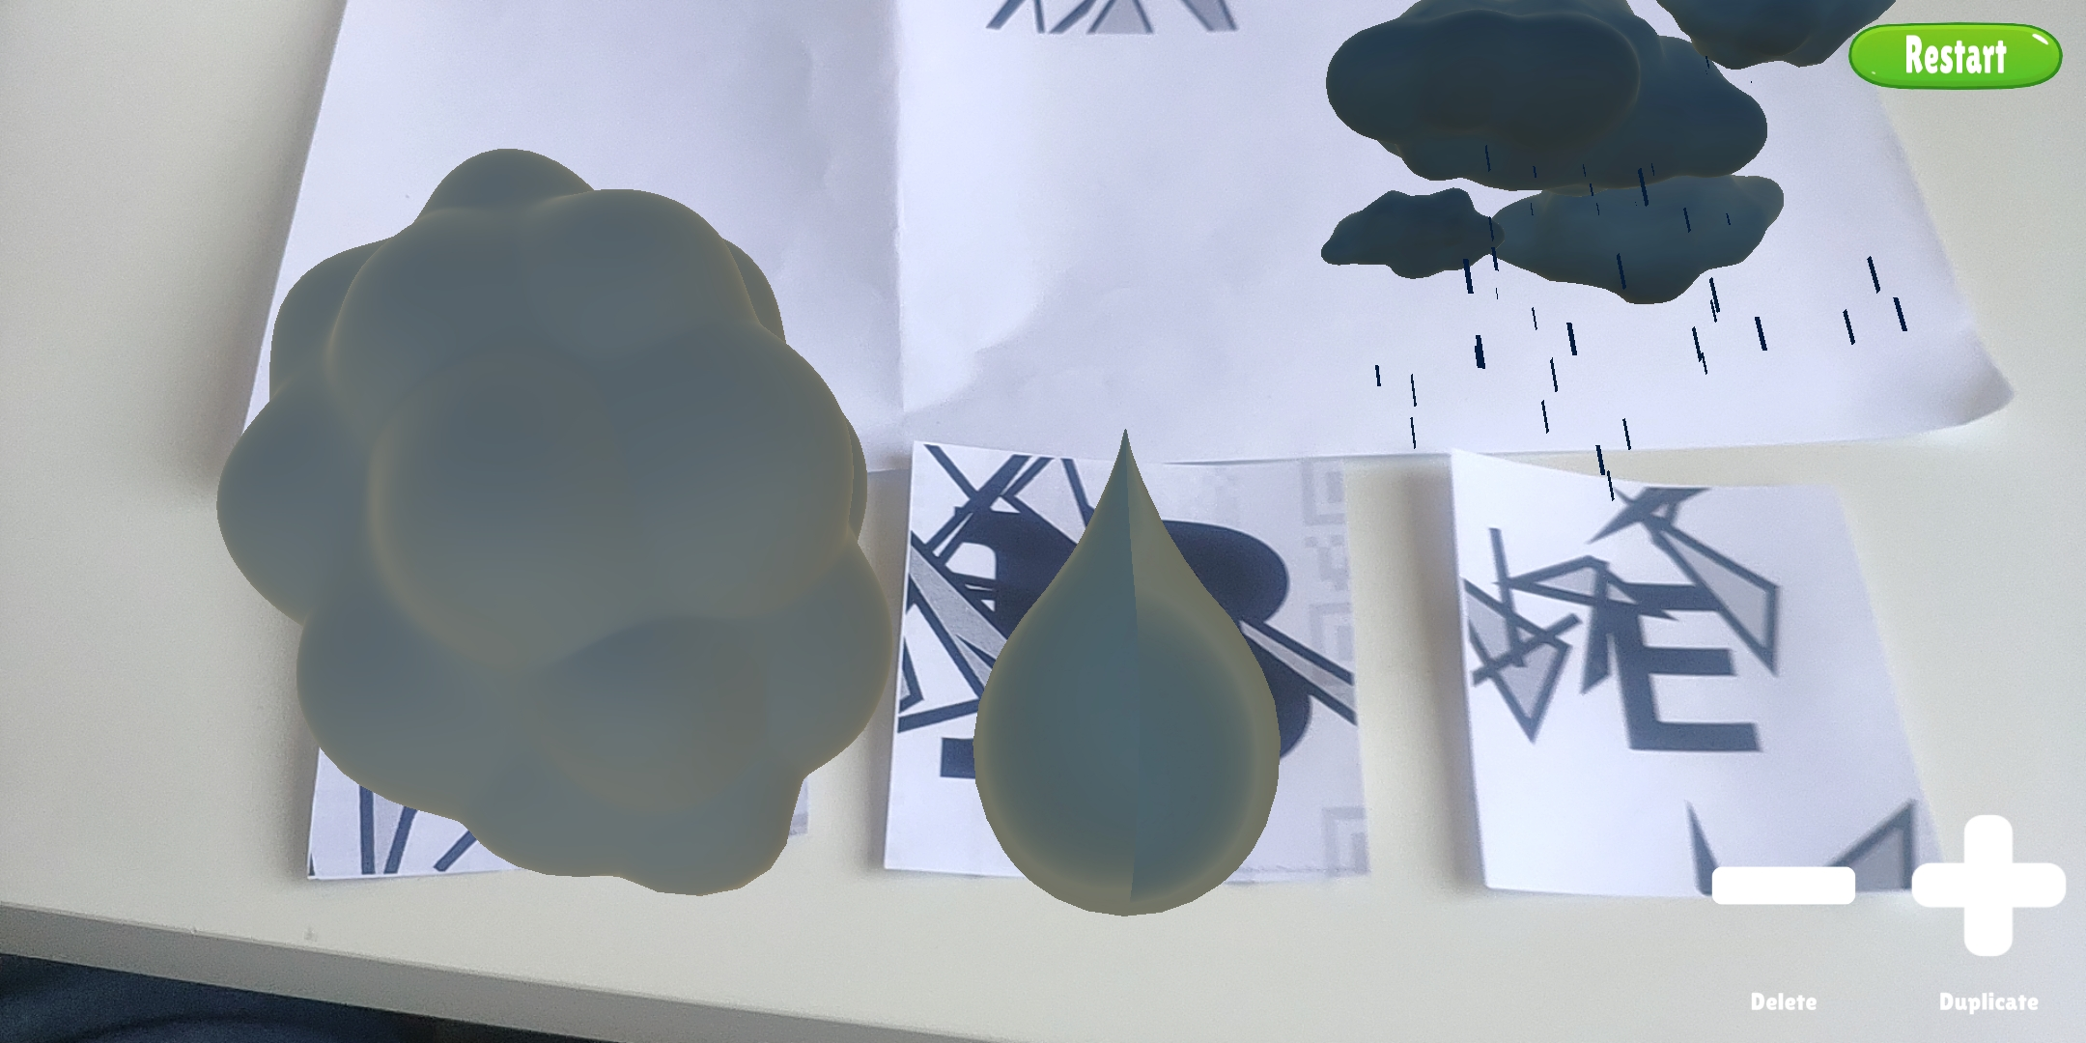
Gameplay – First Combination
Combination possible when
Both of elements are combinable
An empty marker is detected
💧
☁️
🌧️
Empty
Marker
Water
Cloud
Rain
💧
🌧️
☁️
Notes:
What is the first combination going on? Elaborate the combination progress, what is empty marker. Play the animation

Slide 8
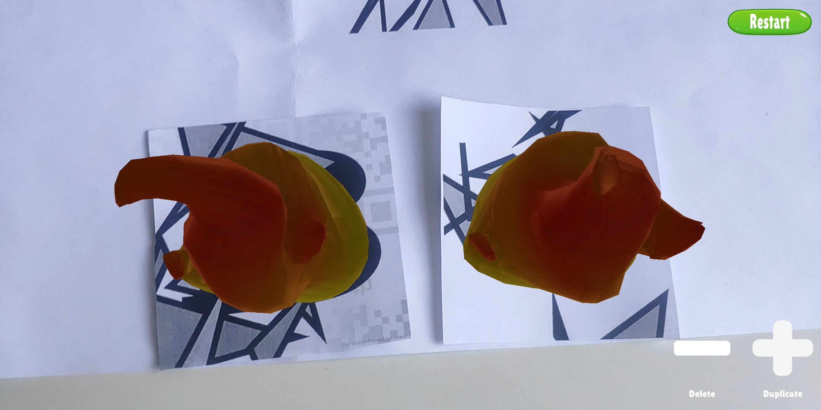
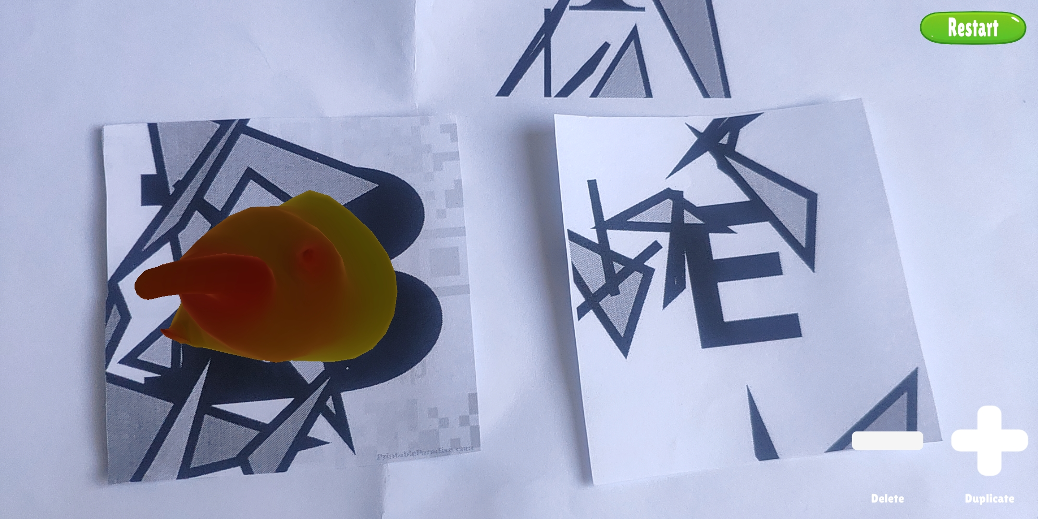

Gameplay – Handle duplicate combination
The bottom button + and – are designed for duplicating basic elements
Or removing already assigned elements
🔥+🔥 = ⚡(Energy)
🔥
🔥
🔥
Empty Marker
Fire
Click
Notes:
If we want to get Energy, we need two fire, so how to duplicate, what is the function of bottom UI buttons?

Slide 9
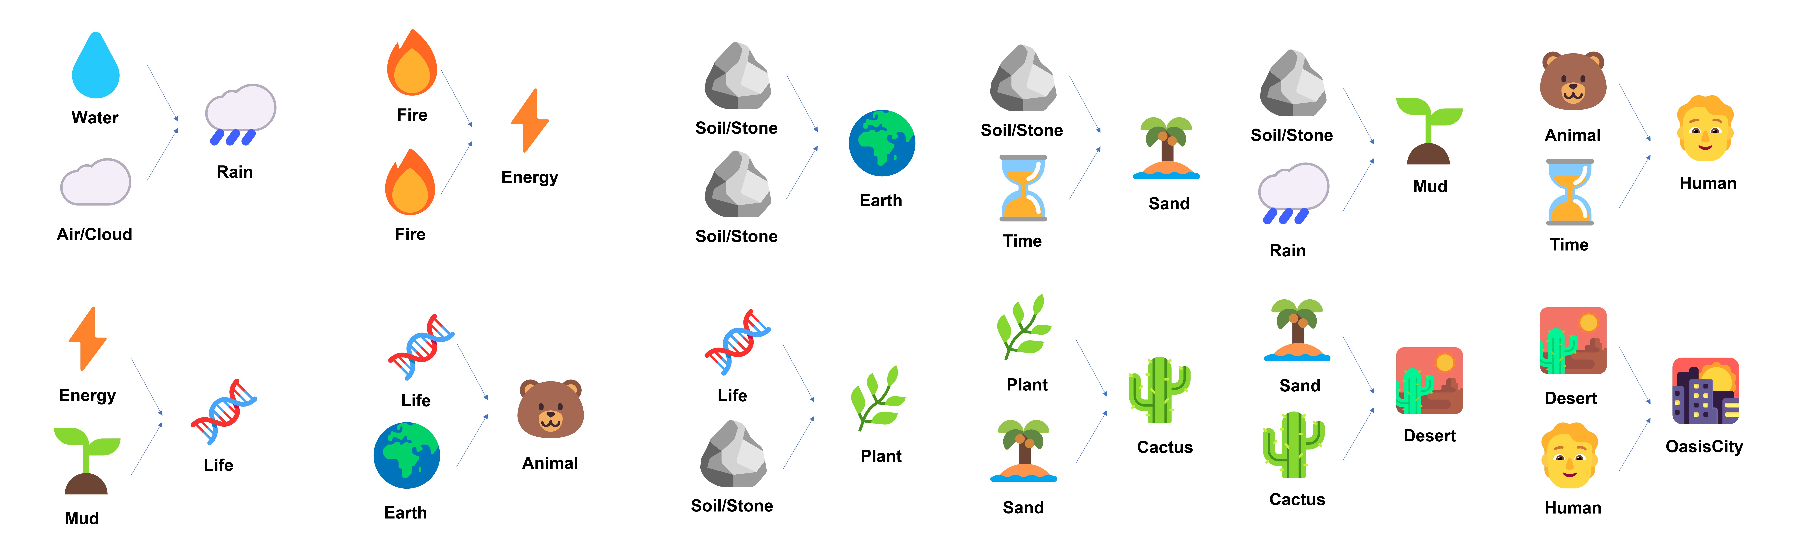
Spoiler
Some possible combinations in Level 1
Notes:
Some clues for level one

Slide 10
Thank you for your attention!
AR Project Team 10
Ao Gao, Fabian Nhan, Klejdi Sinollari, Sheng-Chia Yu, Chang Luo
AR-Alchemy | AR Project SS2022 | 19. June. 2022
Notes:
Thank you for your listening. And the one taking the presentation. You‘re my hero.

